Slide 1



Elastic Talk – Danske Bank
David Thejl-Clayton
@DCSecuritydk

Slide 2

A little about me
Lived in Denmark 5 years, with my wife and 2 kids..
Cyber Defence Center Department Manager at JN Data
I love open source security solutions, I run the Security Distractions blog with a friend… https://www.securitydistractions.com/
I am also the chairman of BSides Aarhus, coming summer 2020!

Slide 3
Introduction
Tonight I will tell you a story of how I built an open source detection lab, and how incredibly distracted I got during the process…
The why?
The how?
The distraction!

Slide 4
The why?

Slide 5

Detecting threats is expensive!
It’s not expensive if you don’t have to pay for anything!

Slide 6
Can you build detection capabilities using only open source tooling?
Lets see… Shall we…

Slide 7
The how?

Slide 8

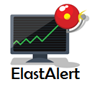

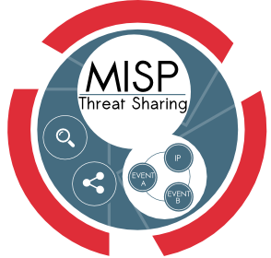






WAN
ELK
TheHive
Util
LAN
DNS
IDS
Proxy
Firewall
Workstation
Windows Domain
SecDis
Domain Controller, File Server
CrownJewels

Slide 9
Makes sense right?
Here is a more logical drawing…

Slide 10
Host centric!
www.totallylegit.dk
www.totallylegit.dk
https://www.totallylegit.dk
193.162.100.10
193.162.100.10
193.162.100.10
193.162.100.10
Windows10.secdis.net
Proxy
IDS
Firewall
www.totallylegit.dk
CrownJewel01.secdis.net
DNS

Slide 11
Wait, David… This is a logging talk, where is the logging…
Its coming… Here is my view of basic logging architecture…

Slide 12
Storage
(Indexed)
Ship
Normalize
Enrich
Transport
Query/Visualize
Log Sources
Detection
Schema

Slide 13
But this is an Elastic talk, where is ELK?? I demand ELK…

Slide 14
ELK Stack
Made up of the following components:-
Beats – Log shipper (Winlogbeat, Filebeat, Packetbeat etc etc)
Logstash – Parsing logs, transforming and transporting them
Elasticsearch – Indexing and storing of data
Kibana – Displaying data from Elasticsearch and querying it, new SIEM app too!
Indexes on ingestion (sales sales sales)

Slide 15
So how do we map ELK into the log architecture drawing?

Slide 16
ElasticSearch
Storage
(Indexed)
Beats
Logstash
Kibana
Ship
Normalize
Enrich
Transport
Query/Visualize
Log Sources
????
Detection
Schema
ECS
Elastic Common Schema

Slide 17
You don’t mention correlation! You need a SIEM tool to do correlation!
Using a schema allows for correlation at ingestion, no additional fancy tooling needed!

Slide 18
Alert on www.totallylegit.dk?
3 rules
cs_host = www.totallylegit.dk
Squid
Schema
(ECS)
hostname = www.totallylegit.dk
destination.domain = www.totallylegit.dk
Alert on www.totallylegit.dk?
1 rule
domain = www.totallylegit.dk

Slide 19
But you mentioned host centric correlation?

Slide 20
Hostname enrichment...
hostname = Windows10.secdis.net
Squid
Host centric correlation!
Enrich
ECS
sourceip = 192.168.20.10
host.name = Windows10.secdis.net
source-host = Windows10.secdis.net

Slide 21
But what about detections?
The watcher sucks! (sorry elastic)…

Slide 22
Elastalert
Python tool developed by YELP…
Utilizes Elasticsearch API…
Built in Python…
Rules are built in YAML…
Modular rule design…
Monitor, Pattern, Alerter...
{
name: TotallyLegit
type: any index: sd-* filter: - query: query_string: query: “destination.domain: www.totallylegit.dk"
alert: hivealerter” }

Slide 23
This only covers one domain…
What about all the others that might be threats to me?
Can I consume threat data into ELK?

Slide 24
DING! Here comes the distraction…
A security distraction…
(See what I did there?)

Slide 25
The Plan
Get
Threat Data
?
Profit
(Enriched logs)
Requirements:-
Scalable = 100.000 events per second, enrichment…
Real time enrichment, enabling speedy detection…

Slide 26

MISP – Malware information sharing platform
Threat Intelligence Sharing Platform
Not just threat data!!
Developed by CIRCL in Luxembourg
Originally a NATO project…
MISP API
Used for automating lots of interesting things…

Slide 27
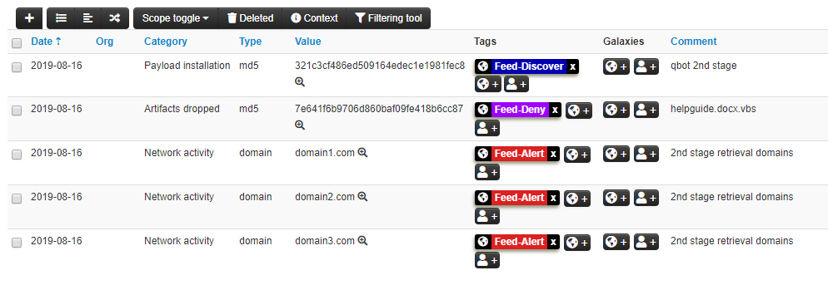
MISP - Example

Slide 28
The Plan
Get
Threat Data
?
Profit
(Enriched logs)
MISP

Slide 29
Some intense whiteboarding and discussions later…

Slide 30
Elastimispstash
Some great security guys have written an integration between ELK and MISP...
Enrichment on ingestion in real time...
Highly scalable...
Currently has support for ECS field types:-
Domain, ip and sha256

Slide 31
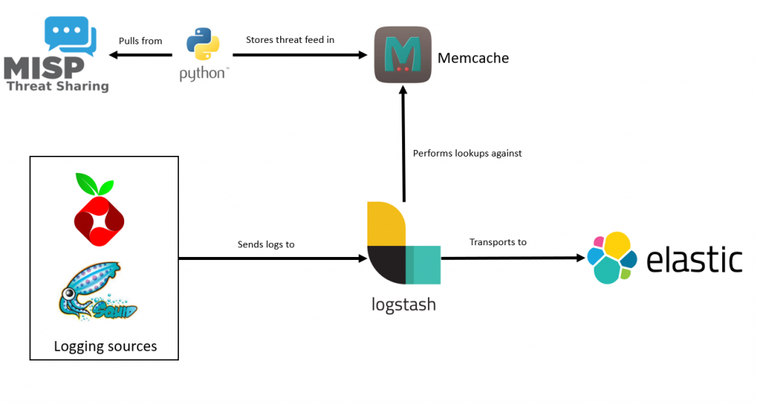
Elastimispstash

Slide 32
Elastimispstash
www.totallylegit.dk
www.nobadfileshere.dk
notbadlinkpleaseclick.com
d@nskebank.dk
jndatas.dk
Elastimispstash
destination.domain = www.totallylegit.dk
Squid
Enrich
destination.domain = www.totallylegit.dk
misp.hit = yes
Detection
destination.domain = www.totallylegit.dk

Slide 33
Ok so what did we learn?

Slide 34
Detecting threats is expensive!
It’s not expensive if you don’t have to pay for anything!

Slide 35
Take homes
Detection and logging doesn’t have to be expensive…
Correlation can be done for free, by using a strict logging schema
Host centric logging craves enrichment of host field
Detections can be done for free, via Elastalet and soon SIEM app
But…
It does take time and commitment to get there, you must learn your logs and know them inside out!

